Slide 1
Agenda
Topics
What is Apache Kafka
Why Apache Kafka
Kafka Architecture
Kafka Fundamental Concepts
Kafka components
Installation
Producer Consumer Examples

Slide 2
Apache Kafka: Introduction
Kafka is a distributed streaming platform
A streaming platform has three key capabilities:
Publish and subscribe to streams of records, similar to a message queue or enterprise messaging system.
Store streams of records in a fault-tolerant durable way.
Process streams of records as they occur.
High Scalable (partition)
Fault Tolerant (replication)
Allow high level of parallelism and decoupling between data producers and data consumers
Critical component of most of the Big Data Platform and therefore of Hadoop ecosystem
Notes:
Kafka is a distributed streaming platform that is used publish and subscribe to streams of records. Kafka gets used for fault tolerant storage. Kafka replicates topic log partitions to multiple servers. Kafka is designed to allow your apps to process records as they occur. Kafka is fast, uses IO efficiently by batching, compressing records. Kafka gets used for decoupling data streams. Kafka is used to stream data into data lakes, applications and real-time stream analytics systems.

Slide 3
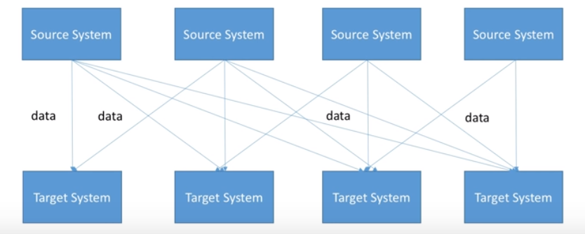
Why Apache Kafka: Challenge with previous arch
If you have 4 Source systems, and 4 target systems, you need to write 16 integrations
Each integration comes with difficulties around
Protocol - how the data is transported(TCT,HTTP,REST,FTP,JDBC..)
Data Format - how the data is parsed(Binary,CSV,JSON,Avro..)
Data schema & Evolution - How the data is shaped and may change

Slide 4
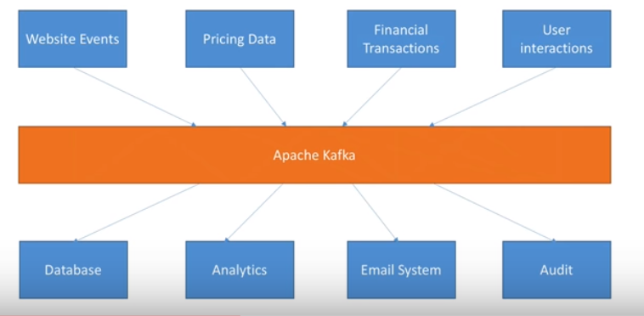
Why Apache Kafka: Decoupling of Data Streams and Systems
Notes:
How does Kafka decouple streams of data? It decouple streams of data by allowing multiple consumer groups that can each control where in the topic partition they are. The producers don’t know about the consumers. Since the Kafka broker delegates the log partition offset (where the consumer is in the record stream) to the clients (Consumers), the message consumption is flexible. This allows you to feed your high-latency daily or hourly data analysis in Spark and Hadoop and the same time you are feeding microservices real-time messages, sending events to your CEP system and feeding data to your real-time analytic systems.

Slide 5
Why Apache Kafka cont…
Distributed, resilient architecture, Fault Tolerant
Horizontal Stability
Can scale to 100s of brokers(kafka servers)
Can scale to millions of messages per second
High Performance (latency of less than 10 ms) – real time
Real time streaming data processed for real time analytics, Service calls, track every call, IOT sensors
Higher throughput, reliability and replication.

Slide 6
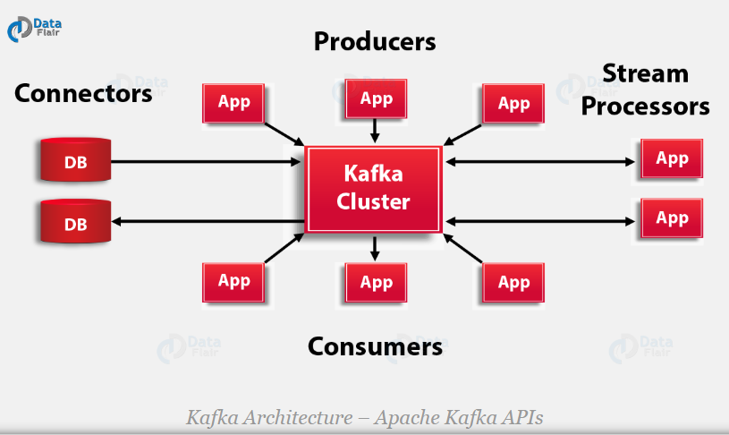
Kafka Architecture – Apache Kafka APIs
Apache Kafka Architecture has four core APIs, producer API, Consumer API, Streams API, and Connector API
Notes:
a. Producer API
In order to publish a stream of records to one or more Kafka topics, the Producer API allows an application.
b. Consumer API
This API permits an application to subscribe to one or more topics and also to process the stream of records produced to them.
c. Streams API
Moreover, to act as a stream processor, consuming an input stream from one or more topics and producing an output stream to one or more output topics, effectively transforming the input streams to output streams, the streams API permits an application.
d. Connector API
While it comes to building and running reusable producers or consumers that connect Kafka topics to existing applications or data systems, we use the Connector API. For example, a connector to a relational database might capture every change to a table.

Slide 7
Kafka Fundamental Concepts/Ecosystem
Broker: Kafka node on the cluster
Topics: Stream of records category
- Multiple writers and readers
Partitioned
Replicated
Producer: push messages into a Kafka topic
Consumer: pulls messages off of a Kafka topi
Data Retention:
- Based on time or size
Zookeeper: Stores Kafka Metadata
Notes:
a. Kafka Broker
Basically, to maintain load balance Kafka cluster typically consists of multiple brokers. However, these are stateless, hence for maintaining the cluster state they use ZooKeeper. Although, one Kafka Broker instance can handle hundreds of thousands of reads and writes per second. Whereas, without performance impact, each broker can handle TB of messages. In addition, make sure ZooKeeper performs Kafka broker leader election.
b. Kafka – ZooKeeper
For the purpose of managing and coordinating, Kafka broker uses ZooKeeper. Also, uses it to notify producer and consumer about the presence of any new broker in the Kafka system or failure of the broker in the Kafka system. As soon as Zookeeper send the notification regarding presence or failure of the broker then producer and consumer, take the decision and starts coordinating their task with some other broker.
c. Kafka Producers
Further, Producers in Kafka push data to brokers. Also, all the producers search it and automatically sends a message to that new broker, exactly when the new broker starts. However, keep in mind that the Kafka producer sends messages as fast as the broker can handle, it doesn’t wait for acknowledgments from the broker.
d. Kafka Consumers
Basically, by using partition offset the Kafka Consumer maintains that how many messages have been consumed because Kafka brokers are stateless. Moreover, you can assure that the consumer has consumed all prior messages once the consumer acknowledges a particular message offset. Also, in order to have a buffer of bytes ready to consume, the consumer issues an asynchronous pull request to the broker. Then simply by supplying an offset value, consumers can rewind or skip to any point in a partition. In addition, ZooKeeper notifies Consumer offset value.

Slide 8
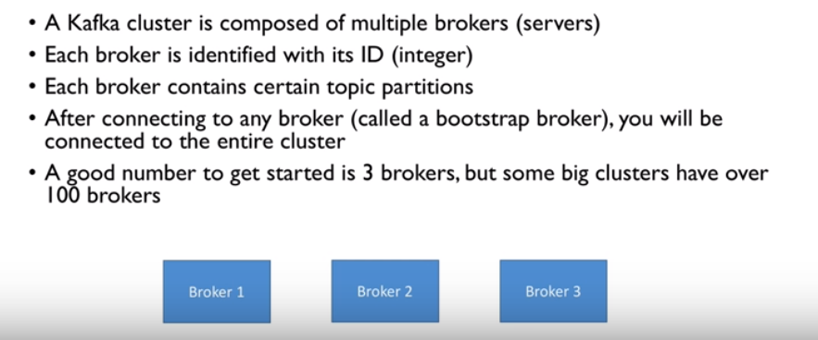
Kafka : Brokers
Notes:
./bin/kafka-topics.sh --describe --topic demo --zookeeper ilrtvit053:2181
"leader" is the node responsible for all reads and writes for the given partition. Each node will be the leader for a randomly selected portion of the partitions.
"replicas" is the list of nodes that replicate the log for this partition regardless of whether they are the leader or even if they are currently alive.
"isr" is the set of "in-sync" replicas. This is the subset of the replicas list that is currently alive and caught-up to the leader.

Slide 9
Kafka : Topics and Partition
The topic is a logical channel to which producers publish message and from which the consumers receive messages.
A topic defines the stream of a particular type/classification of data, in Kafka.
Messages are structured or organized.
A particular type of messages is published on a particular topic.
In a Kafka cluster, a topic is identified by its name and must be unique.
There can be any number of topics, there is no limitation.
We can not change or update data, as soon as it gets published.

Slide 10
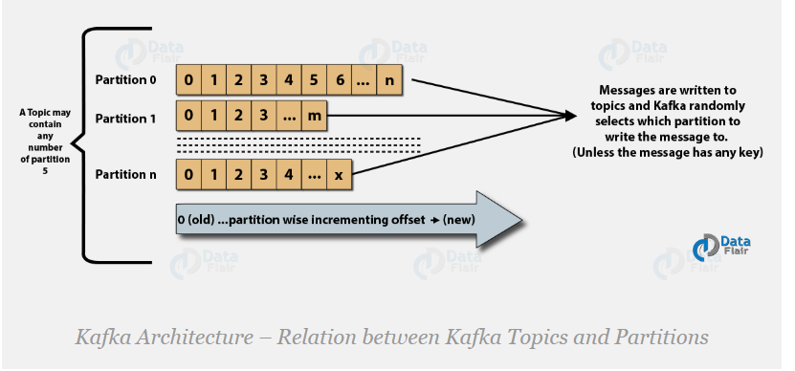
Kafka : Topics’ Partitions
Topics are split into Partitions and also replicated across brokers.
However, to which partition a published message will be written, there is no guarantee
Also, we can add a key to a message. Due to this feature, Kafka offers message sequencing guarantee.
In one partition, messages are stored
in the sequenced fashion.
In a partition, each message is
assigned an incremental id, (offset).
Only within the partition, these offsets
are meaningful.
There can be any number of Partitions
Notes:
Also, we can add a key to a message. Basically, we will get ensured that all these messages (with the same key) will end up in the same partition if a producer publishes a message with a key. Due to this feature, Kafka offers message sequencing guarantee. Though, unless a key is added to it, data is written to partitions randomly.
Only within the partition, these offsets are meaningful. Moreover, in a topic, it does not have any value across partitions.
./bin/kafka-topics.sh --describe --topic demo --zookeeper ilrtvit053:2181
"leader" is the node responsible for all reads and writes for the given partition. Each node will be the leader for a randomly selected portion of the partitions.
"replicas" is the list of nodes that replicate the log for this partition regardless of whether they are the leader or even if they are currently alive.
"isr" is the set of "in-sync" replicas. This is the subset of the replicas list that is currently alive and caught-up to the leader.

Slide 11
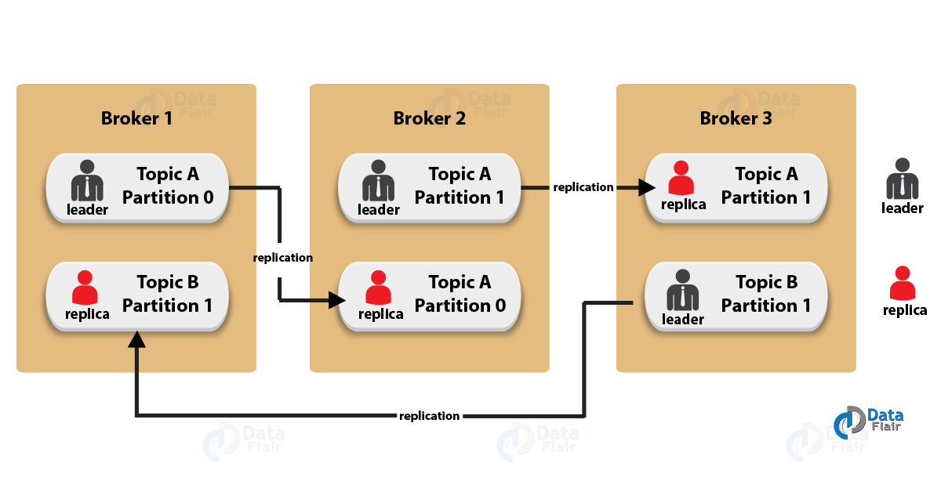
Kafka : Topic Replication Factor in Kafka
Topics’ replicas from another broker can solve the crisis, if a broker goes down
Replication takes place in the partition level only.
For a given partition, only one broker can be a leader, at a time. Meanwhile, other brokers will have in-sync replica
It is not possible to have the number of replication factor more than the number of available brokers.
Notes:
While designing a Kafka system, it’s always a wise decision to factor in topic replication. As a result, its topics’ replicas from another broker can solve the crisis, if a broker goes down. For example, we have 3 brokers and 3 topics. Broker1 has Topic 1 and Partition 0, its replica is in Broker2, so on and so forth. It has got a replication factor of 2; it means it will have one additional copy other than the primary one.
Replication takes place in the partition level only.
For a given partition, only one broker can be a leader, at a time. Meanwhile, other brokers will have in-sync replica; what we call ISR.
It is not possible to have the number of replication factor more than the number of available brokers.

Slide 12
Kafka : Consumer Group
Consumers are grouped into a Consumer Group
Consumer group has a unique id
Each consumer group is a subscriber
Each consumer group maintains its own offset
Multiple subscribers = multiple consumer groups
Exactly one consumer instance reads the data from one partition in one consumer group, at the time of reading.
In more than one consumer group, one instance from each of these groups can read from one single partition.
There will be some inactive consumers, if the number of consumers exceeds the number of partitions
Notes:
It depends on Group ID. Suppose you have a topic with 12 partitions. If you have 2 Kafka consumers with the same Group Id, they will both read 6 partitions, meaning they will read different set of partitions = different set of messages. If you have 4 Kafka cosnumers with the same Group Id, each of them will all read three different partitions etc.
But when you set different Group Id, the situation changes. If you have two Kafka consumers with different Group Id they will read all 12 partitions without any interference between each other. Meaning both consumers will read the exact same set of messages independently. If you have four Kafka consumers with different Group Id they will all read all partitions etc.
However, there will be some inactive consumers, if the number of consumers exceeds the number of partitions. Let’s understand it with an example if there are 8 consumers and 6 partitions in a single consumer group, that means there will be 2 inactive consumers.

Slide 13
Kafka : Record Retention
Kafka cluster retains all published records
Time based – configurable retention period
Size based - configurable based on size
Retention policy of three days or two weeks or a month
It is available for consumption until discarded by time, size
Consumption speed not impacted by size
Notes:
Apache Kafka uses Log data structure to manage its messages. Log data structure is basically an ordered set of Segments whereas a Segment is a collection of messages. Apache Kafka provides retention at Segment level instead of at Message level.
log.retention.hours: The minimum age of the segment file to be eligible for deletion due to age.
log.retention.bytes: A size-based retention policy for logs. Segments are pruned from the log unless the remaining segments drop below log.retention.bytes.
log.segment.bytes: Size of the segment after which a new segment will be created.
log.retention.check.interval.ms: Periodic time interval after which log segments are checked for deletion as per the retention policy. If both retention policies are set, then segments are deleted when either criterion is met.
Apart from Kafka Broker level configuration, it is also possible to configure retention time by means of Topic level configuration using alter command. E.g.. below command can be used to set retention time as 1680 seconds for a Topic with name my-topic:
./bin/kafka-topics.sh --zookeeper localhost:2181 --alter --topic my-topic --config retention.ms=1680000
If required, it is possible to remove Topic level retention time configuration using below command -
./bin/kafka-topics.sh --zookeeper localhost:2181 --alter --topic my-topic --delete-config retention.ms

Slide 14
Kafka needs Zookeeper
Zookeeper helps with leadership election of Kafka Broker and Topic Partition pairs
Zookeeper manages service discovery for Kafka Brokers that form the cluster
Zookeeper sends changes to Kafka
New Broker join, Broker died, etc.
Topic removed, Topic added, etc.
Notes:
Zookeeper is a top-level software developed by Apache that acts as a centralized service and is used to maintain naming and configuration data and to provide flexible and robust synchronization within distributed systems. Zookeeper keeps track of status of the Kafka cluster nodes and it also keeps track of Kafka topics, partitions etc.
Older versions of Kafka (pre 0.9) store offsets in ZK only, while newer version of Kafka, by default store offsets in an internal Kafka topic called __consumer_offsets (newer version might still commit to ZK though).

Slide 15
Kafka Controller Election
In a Kafka cluster, one of the brokers serves as the controller, which is responsible for managing the states of partitions and replicas and for performing administrative tasks like reassigning partitions.
keeping track of nodes in the cluster and appropriately handling nodes that leave, join or fail
A Controller is the broker that reacts to the event of another broker failing. It gets notified from a ZooKeeper Watch.
Every Kafka node heartbeats to ZooKeeper and this keeps its session alive. Once it stops heartbeating, the session expires.
Each broker tries to create an ephemeral node(znode) in the zookeeper (/controller). The first one succeeds, becoming the controller.
When a new controller is elected, it gets a "controller epoch" number by zookeeper.
Notes:
A Controller is the broker that reacts to the event of another broker failing. It gets notified from a ZooKeeper Watch. A ZooKeeper Watch is basically a subscription to some data in ZooKeeper. When said data changes, ZooKeeper will notify everybody who is subscribed to it. ZooKeeper watches are crucial to Kafka — they serve as input for the Controller.
each broker tries to create an ephemeral node(znode) in the zookeeper (/controller). The first one succeeds, becoming the controller. The others just get a proper exception ("node already exists"), and watch on the controller node. When the controller dies, the ephemeral node is removed, and the watching brokers are notified. And again, the first one among them which succeeds in registering the ephemeral node, becomes the new controller, the others will once again get the "node already exists" exception and keep on waiting.
The tracked data in question here is the set of brokers in the cluster.
As shown below, Broker 2’s id is deleted from the list due to the expiry of the faulty broker’s ZooKeeper Session (Every Kafka node heartbeats to ZooKeeper and this keeps its session alive. Once it stops heartbeating, the session expires).
The controller gets notified of this and acts upon it. It decides which nodes should become the new leaders for the affected partitions. It then informs every associated broker that it should either become a leader or start replicating from the new leader via a LeaderAndIsr request.
Going internally, each broker tries to create an ephemeral node in the zookeeper (/controller). The first one succeeds, becoming the controller. The others just get a proper exception ("node already exists"), and watch on the controller node. When the controller dies, the ephemeral node is removed, and the watching brokers are notified. And again, the first one among them which succeeds in registering the ephemeral node, becomes the new controller, the others will once again get the "node already exists" exception and keep on waiting.
How would you know who is the controller in Kafka?
When a new controller is elected, it gets a "controller epoch" number by zookeeper. The brokers know the current controller epoch and if they receive a message from a controller with an older number, they know to ignore it.
In order to find which broker is the controller of a cluster you first need to connect to Zookeeper through ZK CLI:
./bin/zkCli.sh -server localhost:2181
and then get the controller
[zk: localhost:2181(CONNECTED) 0] get /controller

Slide 16
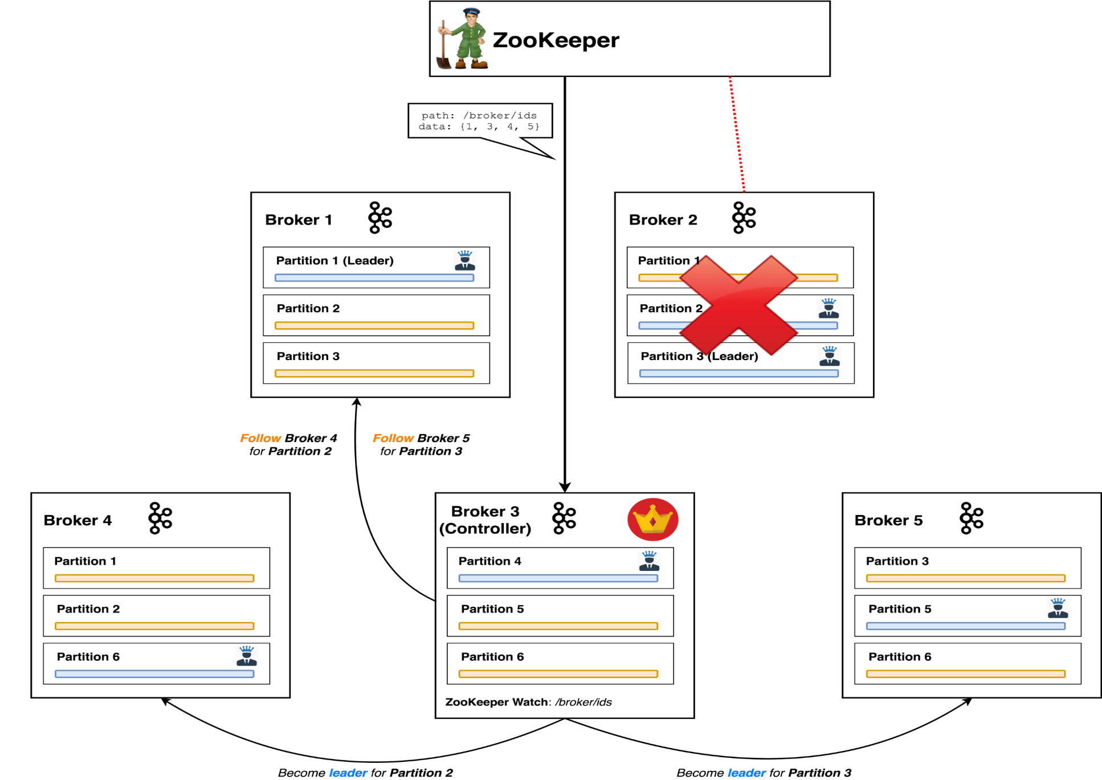
Kafka Controller

Slide 17
Zookeeper Installation:
Download ZooKeeper from here. (https://www.apache.org/dyn/closer.cgi/zookeeper/)
Copy apache-zookeeper-3.5.6-bin.tar.gz to HOME location and Unzip the file. Inside the conf directory, rename the file zoo_sample.cfg as zoo.cfg.
The zoo.cfg file keeps configuration for ZooKeeper, i.e. on which port the ZooKeeper instance will listen, data directory, etc.
The default listen port is 2181. You can change this port by changing clientPort.
The default data directory is /tmp/data. Change this, as you will not want ZooKeeper's data to be deleted after some random timeframe. Create a folder with the name data in the ZooKeeper directory and change the dataDir in zoo.cfg.
Go to the bin directory.
Start ZooKeeper by executing the command ./zkServer.sh start.
Stop ZooKeeper by stopping the command ./zkServer.sh stop.
Notes:
Zookeeper is a top-level software developed by Apache that acts as a centralized service and is used to maintain naming and configuration data and to provide flexible and robust synchronization within distributed systems. Zookeeper keeps track of status of the Kafka cluster nodes and it also keeps track of Kafka topics, partitions etc.
Kafka uses Zookeeper to do leadership election of Kafka Broker and Topic Partition pairs. Kafka uses Zookeeper to manage service discovery for Kafka Brokers that form the cluster. Zookeeper sends changes of the topology to Kafka, so each node in the cluster knows when a new broker joined, a Broker died, a topic was removed or a topic was added, etc. Zookeeper provides an in-sync view of Kafka Cluster configuration.
Zookeeper it self is allowing multiple clients to perform simultaneous reads and writes and acts as a shared configuration service within the system. The Zookeeper atomic broadcast (ZAB) protocol is the brains of the whole system, making it possible for Zookeeper to act as an atomic broadcast system and issue orderly updates.
ZooKeeper performs many tasks for Kafka but in short, we can say that ZooKeeper manages the Kafka cluster state.

Slide 18
Kafka Installation:
Download the latest stable version of Kafka from https://kafka.apache.org/downloads.
Unzip this file in Unix Home location. The Kafka instance (Broker) configurations are kept in the config directory.
Go to the config directory. Open the file server.properties.
Remove the comment from listeners property, i.e. listeners=PLAINTEXT://:9092. The Kafka broker will listen on port 9092.
Change log.dirs to /kafka_home_directory/kafka-logs.
Check the zookeeper.connect property and change it as per your needs. The Kafka broker will connect to this ZooKeeper instance.
Notes:
ilrtvit053:2181 is the Zookeeper address that we defined in the server.properties file in the previous article replication-factor: if Kafka is running in a cluster, this determines on how many brokers a partition will be replicated. The partitions argument defines how many partitions are in a topic.
After a topic is created you can increase the partition count but it cannot be decreased.
demo, here, is the topic name.
broker.id: The ID of the broker instance in a cluster.
zookeeper.connect: The ZooKeeper address (can list multiple addresses comma-separated for the ZooKeeper cluster). Example: localhost:2181,localhost:2182.
zookeeper.connection.timeout.ms: Time to wait before going down if, for some reason, the broker is not able to connect.

Slide 19
Useful Kafka Commands:
./bin/kafka-server-start.sh config/server.properties
bin/kafka-server-start.sh -daemon config/server.properties
nohup bin/kafka-server-start.sh config/server.properties &
./bin/kafka-server-stop.sh
./bin/kafka-topics.sh --list --zookeeper ilrtvit053:2181
./bin/kafka-topics.sh --create --zookeeper ilrtvit053:2181 --replication-factor 1 --partitions 10 --topic demo
./bin/kafka-topics.sh --create --bootstrap-server localhost:9092 --replication-factor 3 --partitions 1 --topic my-replicated-topic
./bin/kafka-topics.sh --zookeeper ilrtvit053:2181 --delete --topic demo
./bin/kafka-topics.sh --describe --topic demo --zookeeper ilrtvit053:2181
./bin/kafka-consumer-groups.sh --list --bootstrap-server ilrtvit388:9092
/zookeeper-shell.sh ilrtvit053:2181
./zookeeper-shell.sh ilrtvit053:2181 <<< "ls /brokers/ids"
Notes:
ilrtvit053:2181 is the Zookeeper address that we defined in the server.properties file in the previous article replication-factor: if Kafka is running in a cluster, this determines on how many brokers a partition will be replicated. The partitions argument defines how many partitions are in a topic.
After a topic is created you can increase the partition count but it cannot be decreased.
demo, here, is the topic name.

Slide 20
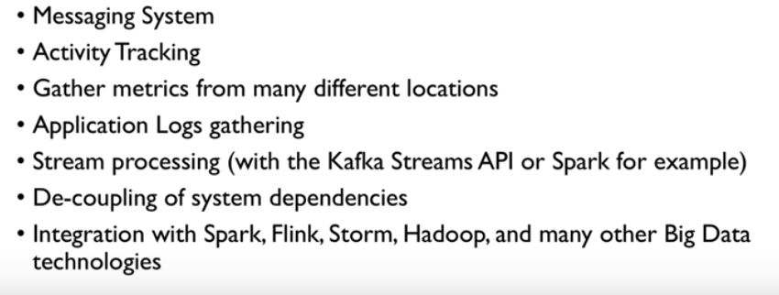
Apache Kafka : Use cases
Kafka is generally used for two broad classes of applications:
Building real-time streaming data pipelines that reliably get data between systems or applications
Building real-time streaming applications that transform or react to the streams of data

Slide 21
Kafka vs JMS, SQS, RabbitMQ Messaging
JMS/ other MOM | Kafka
With queues, when first consumer consumes a message, others cannot take it anymore. | Kafka is a queue system per consumer in consumer group so it can do load balancing like JMS, RabbitMQ queue. it allows scaling between members of the same consumer group
With topics, multiple consumers receive each message but it is much harder to scale | it allows broadcasting the same message between many different consumer groups.
increase number of consumers? You have to reconfigure manually the whole system. | Kafka provides automatic rebalancing
the broker takes care about the messages in JMS | Kafka is tremendously faster, mostly because of some clever disk/memory transfer techniques and because consumers take care about the messages they consumed
Notes:
Kafka guarantees ordered delivery only within a single partition. Period. If you are using multiple partitions (which is a must to have the parallelism), then it is possible that a consumer who listens on several partitions gets a message A from partition 1 before a message B from partition 2, even though message B arrived first.
Now, about the differences between Kafka and JMS. In JMS, you have a queue and you have a topic. With queues, when first consumer consumes a message, others cannot take it anymore. With topics, multiple consumers receive each message but it is much harder to scale. Consumer group from Kafka is a generalization of these two concepts - it allows scaling between members of the same consumer group, but it also allows broadcasting the same message between many different consumer groups.
Even more important difference is the following. Imagine that you have Kafka topic with 500 partitions and on the other hand, 500 JMS message queues. Let's also imagine that you have certain number of producers and consumers. In case of JMS, you need to configure each of them so they know which queues belong to them. What if e.g. some consumer crashes or you detect that you need to increase number of consumers? You have to reconfigure manually the whole system. This comes for free with Kafka, i.e. Kafka provides automatic rebalancing which is an extremely useful feature.
Finally, Kafka is tremendously faster, mostly because of some clever disk/memory transfer techniques and because consumers take care about the messages they consumed, not the broker like in JMS. Because of this, consumer is also able to "rewind", i.e. reread the messages from e.g. 2 days ago.

Slide 23
Apache Kafka : Entry points
Custom implementation of producer and consumer using Kafka client API
Java, Scala, C++, Python
Kafka Connectors
LogFile, HDFS, JDBC, ElasticSearch…
Logstash
Source and sink
Apache Flume out-of-the-box can use Kafka as
Source, Channel, Sink
Other ingestion or processing tools support Kafka
Apache Spark, LinkedIn Gobblin, Apache Storm…

Slide 24
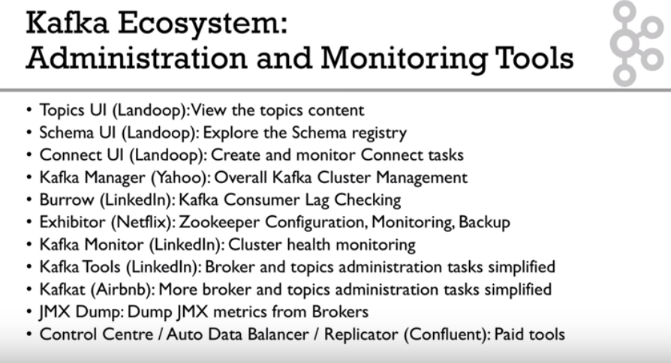
Kafka Administration and Monitoring tools
Notes:
Spring Cloud Context provides utilities and special services for the ApplicationContext of a Spring Cloud application (bootstrap context, encryption, refresh scope and environment endpoints).
Spring Cloud Commons is a set of abstractions and common classes used in different Spring Cloud implementations (eg. Spring Cloud Netflix vs. Spring Cloud Consul).
Spring Cloud Context features:
Bootstrap Context
TextEncryptor beans
Refresh Scope
Spring Boot Actuator endpoints for manipulating the Environment
Spring Cloud Commons features:
DiscoveryClient interface
ServiceRegistry interface
Instrumentation for RestTemplate to resolve hostnames using DiscoveryClient

Slide 25
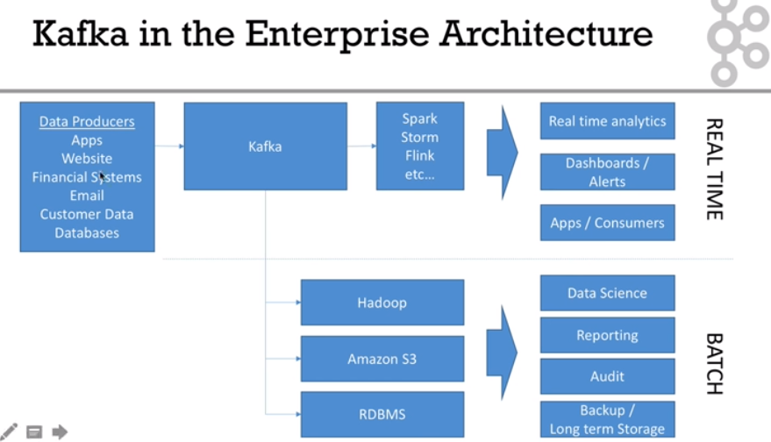

Slide 26
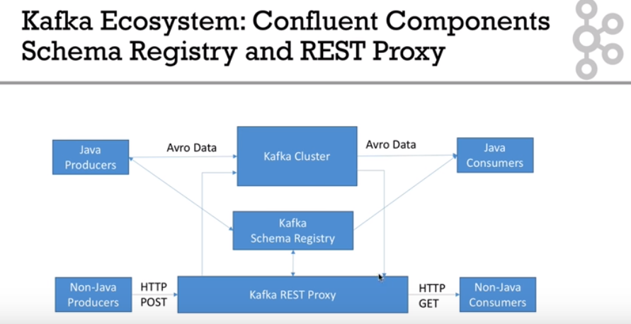

Slide 27
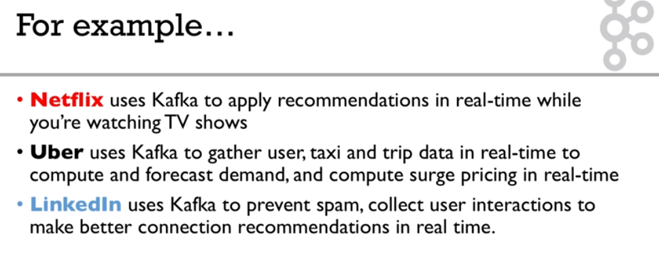
Kafka : Examples

Slide 28
Kafka Scale and Speed
How can Kafka scale if multiple producers and consumers read/write to same Kafka Topic log?
Writes fast: Sequential writes to filesystem are fast (700 MB or more a second)
Scales writes and reads by sharding:
Topic logs into Partitions (parts of a Topic log)
Topics logs can be split into multiple Partitions different machines/ different disks
Multiple Producers can write to different Partitions of the same Topic
Multiple Consumers Groups can read from different partitions efficiently

Slide 29
Kafka Consumer Offsets and Recovery
Kafka stores offsets in topic called “__consumer_offset”
Uses Topic Log Compaction
When a consumer has processed data, it should commit offsets
If consumer process dies, it will be able to start up and start reading where it left off based on offset stored in “__consumer_offset”

